Slide 1

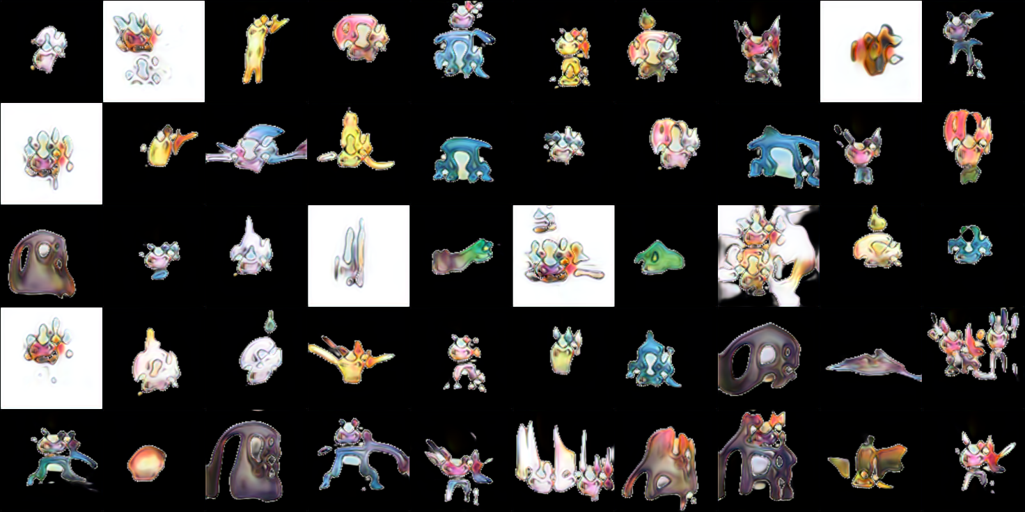
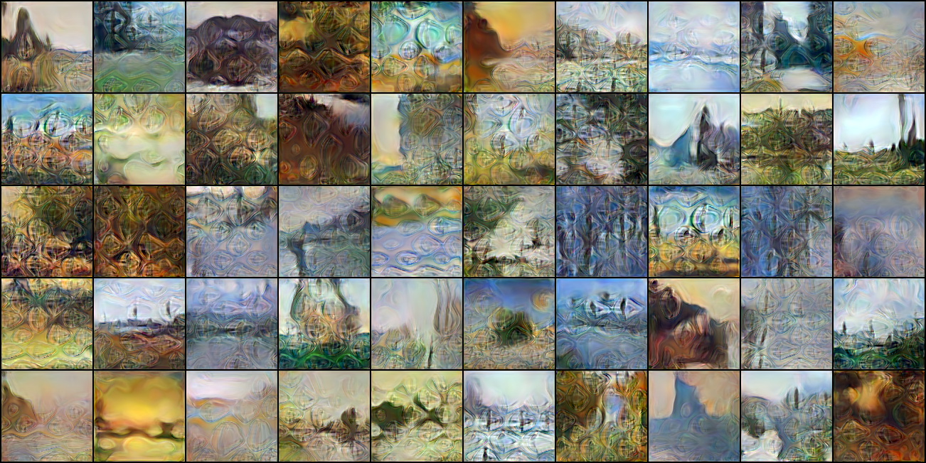
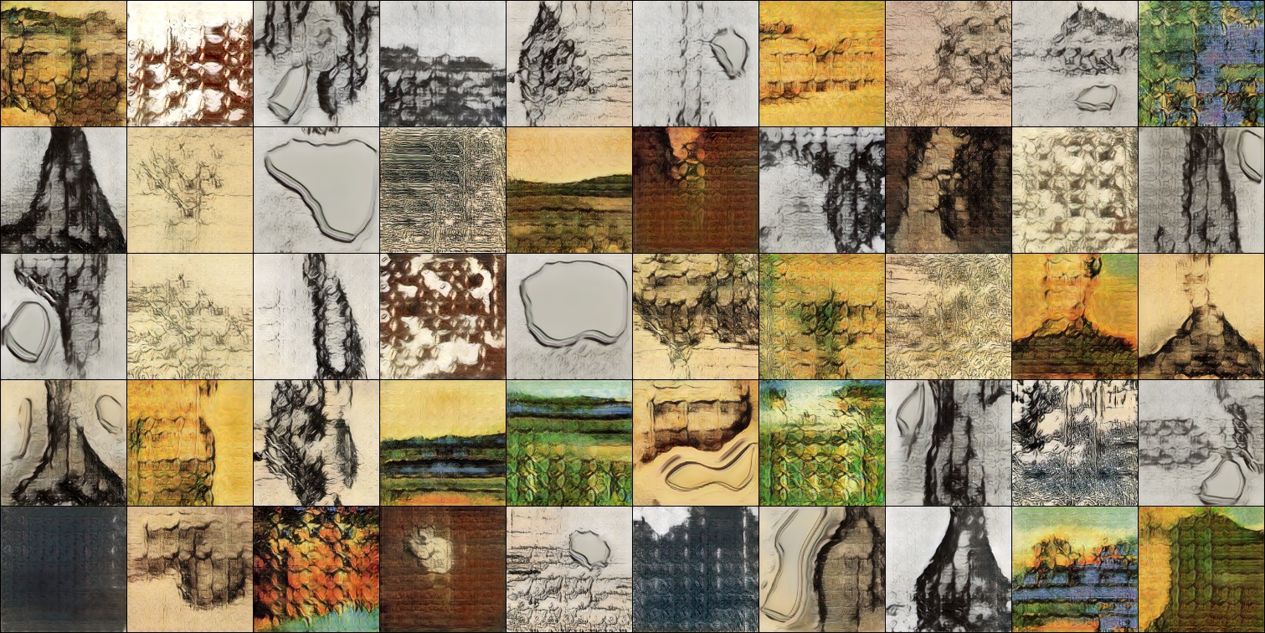
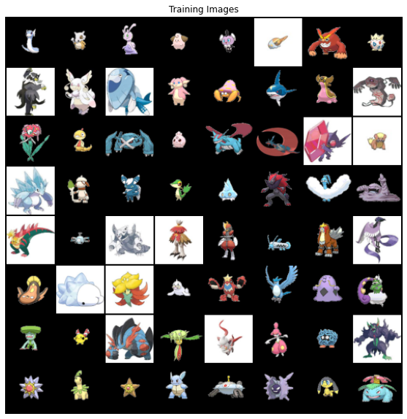
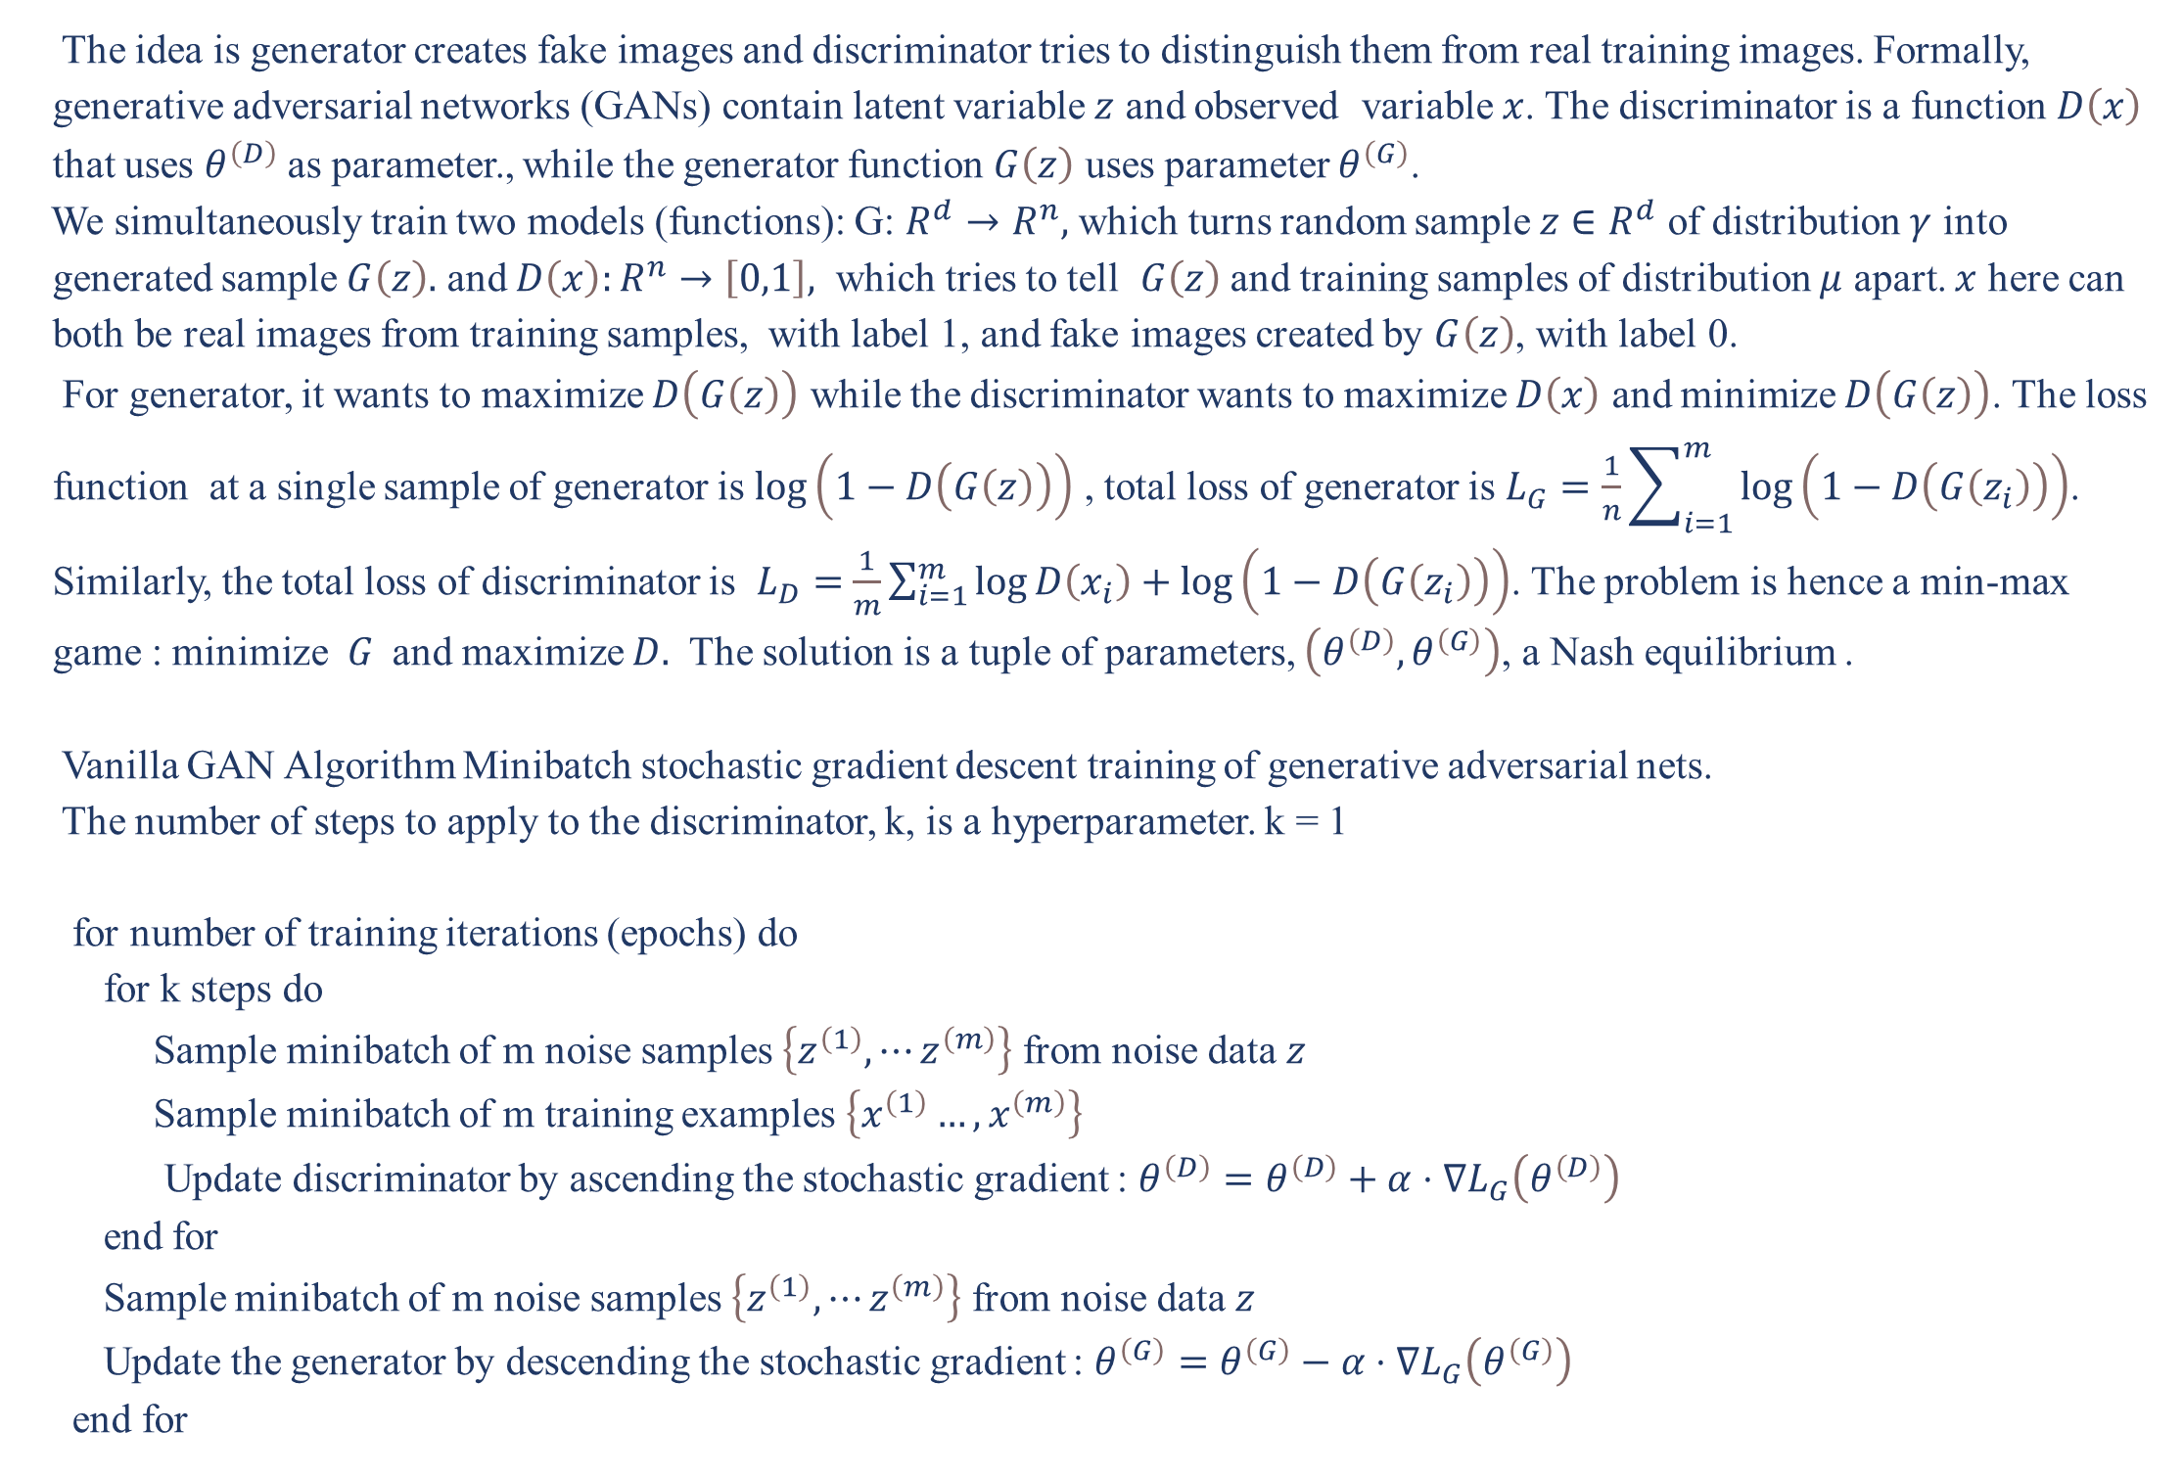
A model for 2D art generation
Xiao Yang, Majid Komeili
Department of Mathematics and Statistics, Department of Computer Science, Carleton University
Abstract
Methods
Results
Generative adversarial network architecture has been very successful in image generation, such as creating non-existent images of buildings and pets. However, most of images created are related to real-world objects; there are few sophisticated networks for creating 2D art images, such as painting and virtual character designs. We propose a modified generative adversarial network based on progressive training technique to automatically generate 2D art works.
The idea is generator creates fake images and discriminator tries to distinguish them from real training images. Formally, generative adversarial networks (GANs) contain latent variable $z$ and observed variable $x$. The discriminator is a function $D\left(x\right)$ that uses $θ^{\left(D\right)}$ as parameter., while the generator function $G\left(z\right)$ uses parameter $θ^{\left(G\right)}$.
We simultaneously train two models (functions): G: $R^{d}→R^{n},$ which turns random sample $z∈R^{d}$ of distribution $γ$ into generated sample $G\left(z\right).$ and $D\left(x\right):R^{n}→\left[0,1\right],$ which tries to tell $G\left(z\right)$ and training samples of distribution $μ$ apart. $x$ here can both be real images from training samples, with label 1, and fake images created by $G\left(z\right)$, with label 0.
For generator, it wants to maximize $D\left(G\left(z\right)\right)$ while the discriminator wants to maximize $D\left(x\right)$ and minimize $D\left(G\left(z\right)\right)$. The loss function at a single sample of generator is $\log\left(1−D\left(G\left(z\right)\right)\right)$ , total loss of generator is $L_{G}=$ $\frac{1}{n}\sum_{i=1}^{m}{\log\left(1−D\left(G\left(z_{i}\right)\right)\right)}$. Similarly, the total loss of discriminator is $L_{D}=$ $\frac{1}{m}\sum_{i=1}^{m}{\log{D\left(x_{i}\right)}}+\log\left(1−D\left(G\left(z_{i}\right)\right)\right)$. The problem is hence a min-max game : minimize $G$ and maximize $D.$ The solution is a tuple of parameters, $\left(θ^{\left(D\right)},θ^{\left(G\right)}\right)$, a Nash equilibrium .
Vanilla GAN Algorithm Minibatch stochastic gradient descent training of generative adversarial nets.
The number of steps to apply to the discriminator, k, is a hyperparameter. k = 1
for number of training iterations (epochs) do
for k steps do
Sample minibatch of m noise samples $\left\{z^{\left(1\right)},⋯z^{\left(m\right)}\right\}$ from noise data $z$
Sample minibatch of m training examples $\left\{x^{\left(1\right)}…,x^{\left(m\right)}\right\}$
Update discriminator by ascending the stochastic gradient : $θ^{\left(D\right)}=θ^{\left(D\right)}+α⋅∇L_{G}\left(θ^{\left(D\right)}\right)$
end for
Sample minibatch of m noise samples $\left\{z^{\left(1\right)},⋯z^{\left(m\right)}\right\}$ from noise data $z$
Update the generator by descending the stochastic gradient : $θ^{\left(G\right)}=θ^{\left(G\right)}−α⋅∇L_{G}\left(θ^{\left(G\right)}\right)$
end for
The output of Van Gogh's data is shown below. The training took around 8 hours, with minimum gradient first occurred at around 150000 epochs. The progressive technique starts to produce high quality images of 1302 x 652 after 200000 epochs. Due to small size of the data, over fitting occurred, but not significantly. The following figures are the final results after 300000 epochs of Pokémon, Van Gogh and Monet’s data set respectively.
Related Works
One of the most impressive project is to create Van Gosh style painting, and another project is to generate fake animation character’s facial image. However, these results along with existing Pokémon related GANs only produce lower quality images, even for small dataset of size 64 x 64. To resolve this issue, we found the Progressive generative adversarial network helpful. Progressive GAN has been renown for their result on creating fake celebrity face images of large size 1024 x 1024. The approach is mainly by adding layers progressively through training to improve the generated image quality. Inspired by their state of art result, we attempt to high quality 2D art design via an improved version of progressive GAN.
Data Set
Progressive Model
Noticeably, there are no sophisticated and comprehensive data set of Pokémon available to use, so we created a rather small data set on Kaggle, which consists of 1009 64 x 64 x 3 images of Pokémon, each image represents one species or form and there are no data augmentation techniques used. Additionally, actual paintings from Van Gogh and Monet are also used for training to produce artworks.
The progressive GAN is a renown result from Nvidia research team [2]. The technique allows us to grow both the generator and discriminator progressively, starting from easier low-resolution images, and add new layers that introduce higher-resolution details as the training progresses. This greatly speeds up training and improves stability in high resolutions. During our first attempt using a vanilla structure, we realized that the model stopped learning after the initial 2500 epochs.
We kept running the model until finishing all 30000 epochs and found out we encountered mode collapse. Hence, we began adding the progressive technique to the original model. After 300000 iterations, the results are more than satisfactory. The initial 50000 iterations, the images are still blurry but with a descent shape. After 200000 iterations, the image quality is already sharp, but still has room to improve. Finally after 300000 iterations, we obtained satisfactory results, even though there is a slight over-fitting in the picture.
The model code module as well as data sets are posted on GitHub: https://github.com/Barnett888/A-model-for-2D-art-generation
Future Work
The image data set can be expanded, as the largest set only contains 1009 images. We can put more images under different directories. On the other hand, other GAN structure such as style GAN and cycle GAN are also worth testing, to reduce overfitting.

Slide 2
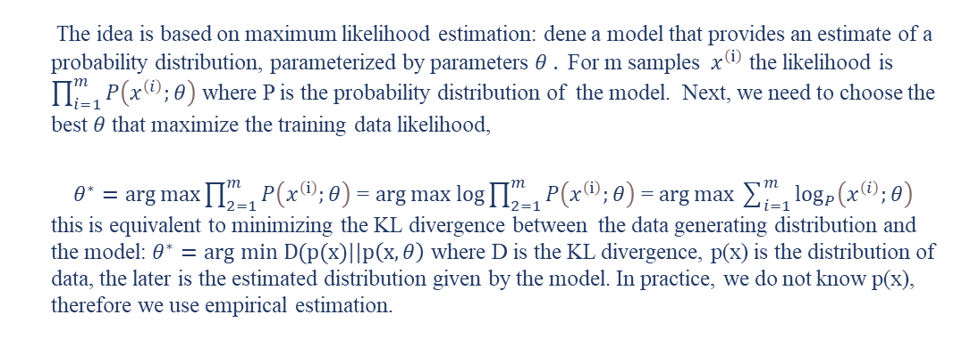
The idea is based on maximum likelihood estimation: dene a model that provides an estimate of a probability distribution, parameterized by parameters $θ .$ For m samples $x^{\left(ⅈ\right)}$ the likelihood is $\prod_{i=1}^{m}{P\left(x^{\left(i\right)};θ\right)}$ where P is the probability distribution of the model. Next, we need to choose the best $θ$ that maximize the training data likelihood,
$θ^{∗}=\arg{\max{\prod_{2=1}^{m}{P\left(x^{\left(ⅈ\right)};θ\right)}}}$ = $\arg{max log{\prod_{2=1}^{m}{P\left(x^{\left(ⅈ\right)};θ\right)}}}$ = $\arg{\max{\sum_{i=1}^{m}{\log_{P}\left(x^{\left(i\right)};θ\right)}}}$ this is equivalent to minimizing the KL divergence between the data generating distribution and the model: $θ^{∗}=arg min D(p(x)||p\left(x,θ\right)$ where D is the KL divergence, p(x) is the distribution of data, the later is the estimated distribution given by the model. In practice, we do not know p(x), therefore we use empirical estimation.

